Slide 1
OBJECT ORIENTED PROGRAMMING

Slide 2
Object-Oriented Programming
All computer programs consist of two elements: code and data.
Program can be conceptually organized around its code or around its data.
These are the two paradigms that govern how a program is constructed.
  process-oriented.
  Object Oriented

Slide 3
Process-oriented programming.
This approach characterizes a program as a series of linear steps (that is, code).
The process-oriented model can be thought of as code acting on data.
Problems with this approach appear as programs grow larger and more complex.
Object-oriented programming
Object-oriented programming organizes a program around its data (that is, objects) and a set of well-defined interfaces to that data.
An object-oriented program can be characterized as data controlling access to code.

Slide 4
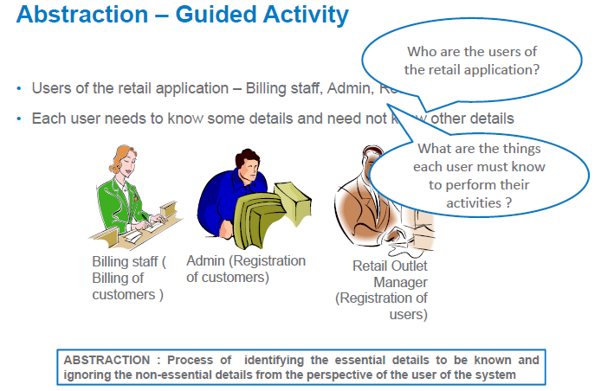

Slide 5
Data Abstraction
The act of representing essential features without including the background details or explanations.

Slide 6
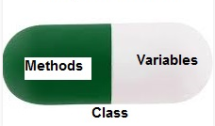
Encapsulation:
In Object Oriented Programming, Encapsulation is defined as binding together the data and the functions that manipulate them.

Slide 7
Encapsulation
Wrapping up of data and methods into a single unit (called class).
The data is not accessible to the outside world and only those methods, which are wrapped in the class, can access it.
These methods provide the interface between the object's data and the program.
This insulation of the data from direct access by 'the program is called datahiding.
Encapsulation makes it possible for objects to be treated like 'black boxes‘.

Slide 8
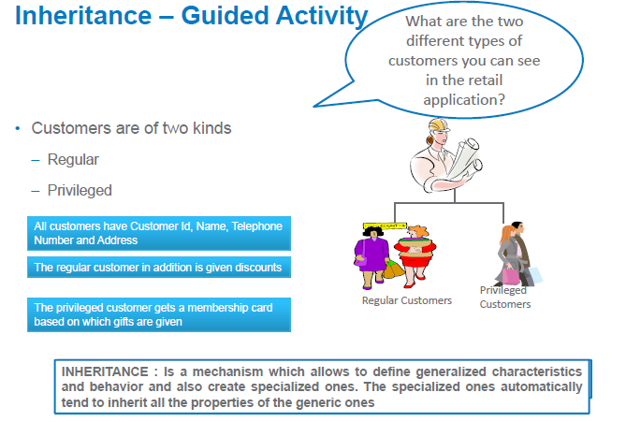

Slide 9
Inheritance
Inheritance provides the idea of reusability: This means that we can add additional features to an existing class without modifying it.
This is possible by deriving a new class from the existing one.
The new class will have the combined features of both the classes.
Subclass defines only those features that are unique to it.
Without the use of inheritance, each class would have to explicitly include all of its features.

Slide 10
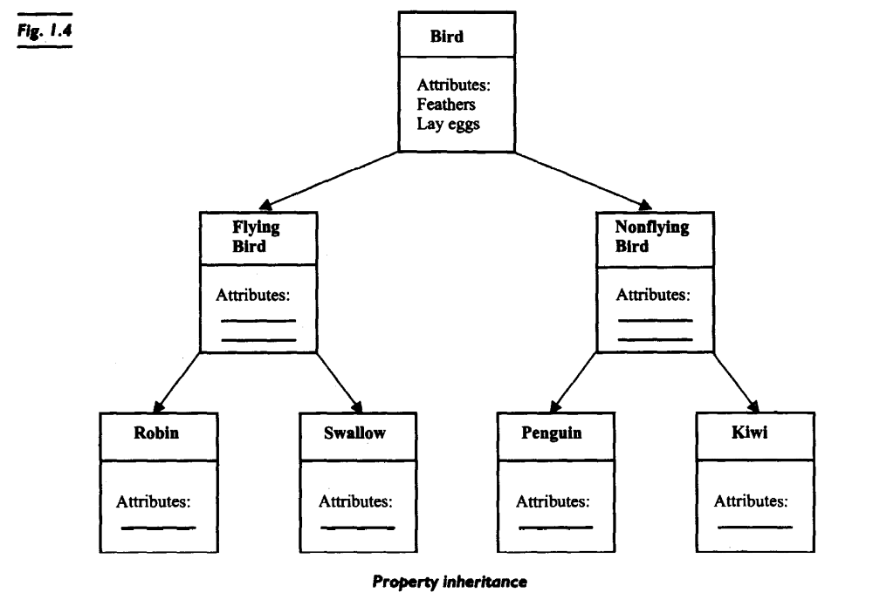
Inheritance

Slide 11
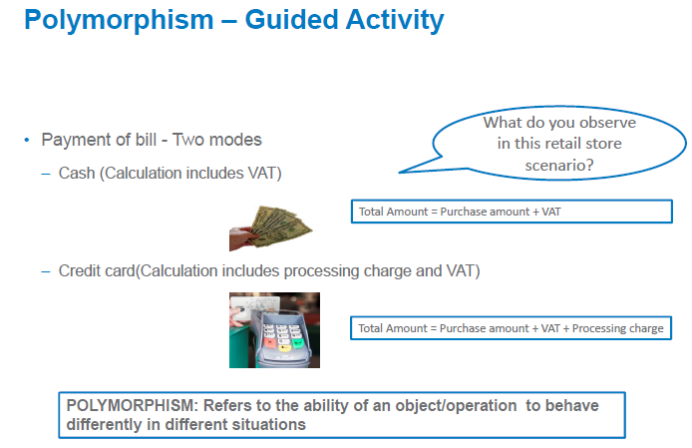

Slide 12
Polymorphism
Polymorphism means the ability to take more than one form.
For example, an operation may exhibit different behavior in different instances.
The behavior depends upon the types of data used in the operation.
For example, consider the operation of addition.
For two numbers, the operation will generate a sum. If the operands are strings, then the operation would produce a third string by concatenation.

Slide 13
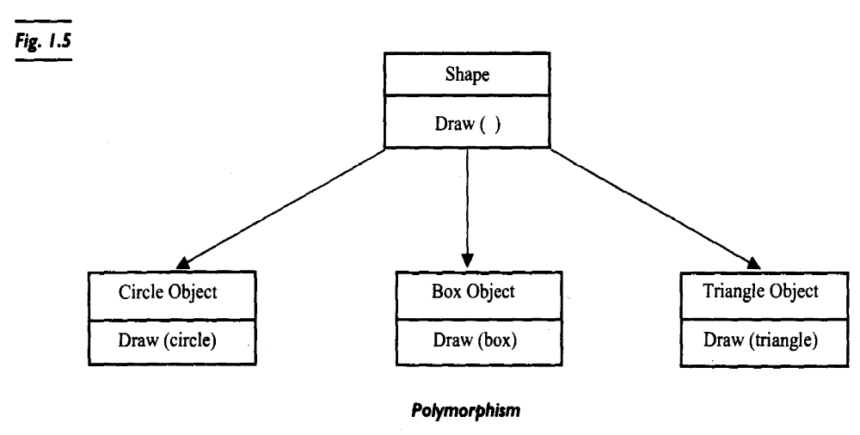
Polymorphism

Slide 14
Object Oriented Approach - Benefits
Through inheritance, we can eliminate redundant code and extend the use of existing classes .
We can build programs from the standard working modules that communicate with one another, rather than having to start writing the code from scratch.
Principle of data hiding helps the programmer to build secure programs.
Reduces the rick factor in building large systems as they are built incrementally from subsystems which are stable.

